Slide 1

MATLAB Table Arrays
Professor Bo Liu
James Watt School of Engineering

Slide 2
MATLAB tables
Tables are commonly used to import and export external data.
  For example, csv data.
MATLAB tables are useful when you have tabular data of different data types. They can be indexed into tables using column names.
MATLAB has built-in functions for common tabular operations.

Slide 3
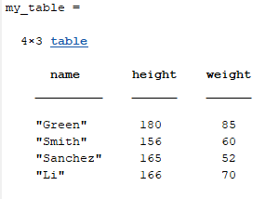
Creating MATLAB tables
MATLAB tables can be created using the table(A1, A2, …, An) function.
  where A1, to An, are columns of data.
  by default, MATLAB uses the variables names as the column headers/names. In this case A1, to An would be the column names.
For example:
name = ["Green"; "Smith"; "Sanchez"; "Li"]
height = [180; 156; 165; 166]
weight = [85; 60; 52; 70]
my_table = table(name , height, weight)
See live script

Slide 4
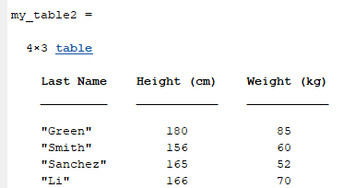
Specifying column names
In the previous example, MATLAB took the names of the variables as the column names.
The table() function takes a second optional keyword argument: VariableNames
  This can be used to provide an array of column names.
name = ["Green"; "Smith"; "Sanchez"; "Li"]
height = [180; 156; 165; 166]
weight = [85; 60; 52; 70]
my_table2 = table(name, height, weight, ...
VariableNames=["Last Name", "Height (cm)", "Weight (kg)"])
See live script

Slide 5
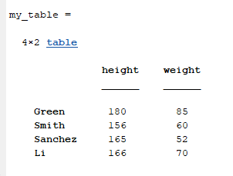
Adding row names to table
It is possible to name the rows of a MATLAB table using the 'RowNames’ argument.
name = ["Green"; "Smith"; "Sanchez"; "Li"]
height = [180; 156; 165; 166]
weight = [85; 60; 52; 70]
my_table = table(height, weight, 'RowNames',name)
See live script

Slide 6
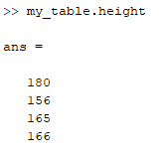
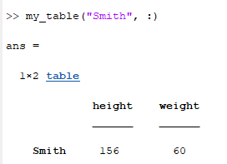
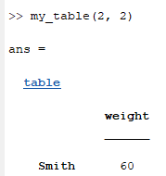
Indexing into a table
Columns in a MATLAB table can be accessed using .name notation.
  The datatype provided by this is an array.
Index a row by parentheses using the row name (it is a string).
Standard parentheses-based matrix indexing can also be used.
  The datatype provided by this is a smaller table.
my_table.height
my_table("Smith", :)
my_table(2, 2)
See live script

Slide 7
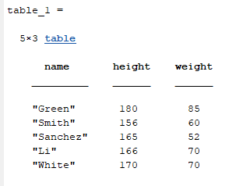
Adding data to MATLAB tables
We can add rows to a MATLAB table via concatenation.
  Concatenation means to combine multiple similar things together.
Example concatenation:
name = ["Green"; "Smith"; "Sanchez"; "Li"]
height = [180; 156; 165; 166]
weight = [85; 60; 52; 70]
table_1 = table(name , height, weight);
table_2 = table("White", 170, 70, VariableNames=["name", "height", "weight"])
table_1 = [table_1; table_2] % concatenate tables 1 and 2
See live script

Slide 8
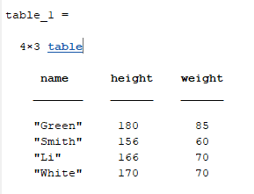
Removing data from a table
We can delete entries from a table by specifying a specific row as an empty matrix:
table_1(3, :) = [] % delete row 3
Row 3 removed from the table
See live script

Slide 9
Questions for you to investigate
What will happen using the following commands:
table_1.height = [];
table_1.age = [10;20;30;40;50];
See live script

Slide 10




Thanks!
#UofGWorldChangers
@UofGlasgow

